Slide 1
App Development Concepts

Slide 2
An app development typically covers concepts like project planning, user interface (UI) design, programming languages specific to the target platform (like Java for Android or Swift for iOS), database management, application logic, testing methodologies, deployment processes, and maintenance strategies; essentially, everything needed to conceptualize, design, build, test, and launch a fully functional mobile application across different operating systems.

Slide 3
Key concepts covered in an app development course may include:
App Development Lifecycle (ADLC):
Understanding the different phases of app development, including requirement analysis, design, development, testing, deployment, and maintenance.

Slide 4
Programming Languages:
Learning the basics of programming languages relevant to mobile app development, such as Java, Kotlin (for Android), Swift, Objective-C (for iOS), or cross-platform frameworks like React Native or Xamarin.

Slide 5
UI/UX Design:
Designing user interfaces that are intuitive and visually appealing, considering user experience principles like wireframing, prototyping, and interaction design.

Slide 6
Database Management:
Working with databases to store and retrieve app data effectively, including concepts like relational databases, NoSQL databases, and data synchronization.

Slide 7
Object-Oriented Programming (OOP):
Applying OOP concepts like classes, objects, inheritance, and polymorphism to structure app code effectively

Slide 8
API Integration:
Integrating external APIs to access data and functionality from other services within an app.

Slide 9
Version Control Systems (VCS):
Using tools like Git to manage code changes and collaborate with other developers.

Slide 10
Testing and Debugging:
Writing unit tests, integration tests, and user acceptance tests to identify and fix bugs in the application.

Slide 11
Deployment:
Publishing apps to the relevant app stores (Google Play Store for Android, Apple App Store for iOS).

Slide 12
other concepts might include:
Mobile Development Frameworks: Using pre-built components and libraries to accelerate development.
Cloud Services: Utilizing cloud platforms for app hosting, data storage, and scaling.
Performance Optimization: Techniques to ensure smooth app performance on different devices.
Security Practices: Implementing security measures to protect user data.

Slide 13
1. Concept development
2. Outlining the app
3. Design considerations and platforms
4. Budget development
5. Programming
6. Graphic design
7. Submission, approval and updates
8. Common pitfalls

Slide 14
Concept development
Identify the purpose of the application (“app”). What will the app do? ● Specify the minimum functionality. Will the app perform a specific task and/or deliver information? ● Most apps do one thing and do it well. ● Avoid overly complex functionality. Example: The “The Plant Doctor” app provides interactive diagnosis for plant health problems. Users submit text and photographs to assist the diagnosis.

Slide 15
Identify the intended users of the app.
Who will use the app? ● What is the target audience? ● Is the app free or for payment? Example: Users of “The Plant Doctor” app include: Farmers, gardeners, homeowners, landscape professionals, County Agents, plant quarantine workers, professionals, and scientists. To date, users reside in 40 foreign countries and in 41 states in the USA.

Slide 16
Different types of audiences
Children Adults Various levels of education Various levels of expertise Types of devices: Android versus iPhone Nationalities: Language, translations Your app and its design should appeal to and serve your target audiences: appearance, colors, functions, tasks

Slide 17
Specify the device(s) to which the app will be delivered
●Web app vs Native app ● Phones vs Tablets ● iPhone vs Android
The choices determine the programming language and coding

Slide 18
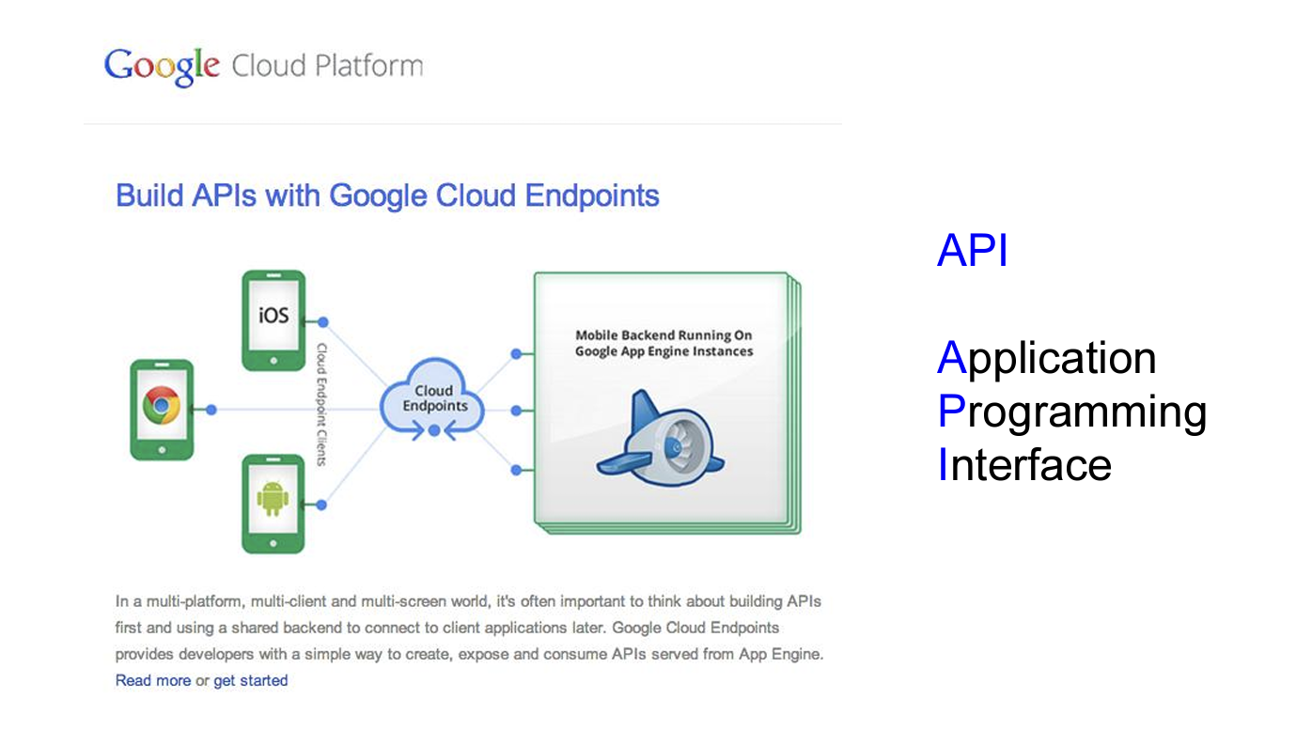

Slide 19
Memory and space considerations
App size is limited only by the space available on a device. There is no recommended size for apps.

Slide 20
Name the app
The app name should accurately reflect the function of the app. The app name should be unique, if possible, and not replicate the names of other apps.

Slide 21
Outlining a draft of the app
● Create a draft step chart: Identify each thing the app will do, in a stepwise fashion. ● Create a draft page chart: Sketch and compose the appearance of various pages. ● Specify the graphics and navigation buttons needed for the app functions ● Specify the outputs and calls

Slide 22
Design considerations
Design the app for fingers (not for a mouse) ● 44 x 44 pixels for buttons ● 6 buttons maximum per width of screen (smart phone) TEXT INPUT: People do not like to type, so keep typing at a minimum TEXT OUTPUT: People generally do not like to read, so keep text at a minimum unless your app is designed primarily to deliver information in text format

Slide 23
Budget development
1. Personal vs. contract development 2. By hour or by project development. Costs per hour vary among countries ($15-20 for India: $50-60 for USA; $100 for USA technical) Example: “The Plant Doctor” app development and deployment cost 80 hours (at the US rate) for each platform (iOS and Android), for a total cost of $9,600.00 ($4,800.00 for each platform).

Slide 24
Programming
Self-programmed versus Contracted programming (note: people without programming experience should probably not try to build an app) Apple (iTunes): programming language = iOS Google (Android): programming language = Java Before budget development: Prepare detailed requirement documents (what the app does). Prepare a detailed use case document (describe each functionality of the app)

Slide 25
Sample pages from the Apple Developers programming software environment appear on the following screens. Remember: Developing an app is writing a program using a specific programming language suited for a particular device. Therefore, a developer should be familiar with the software and the programming language.

Slide 26
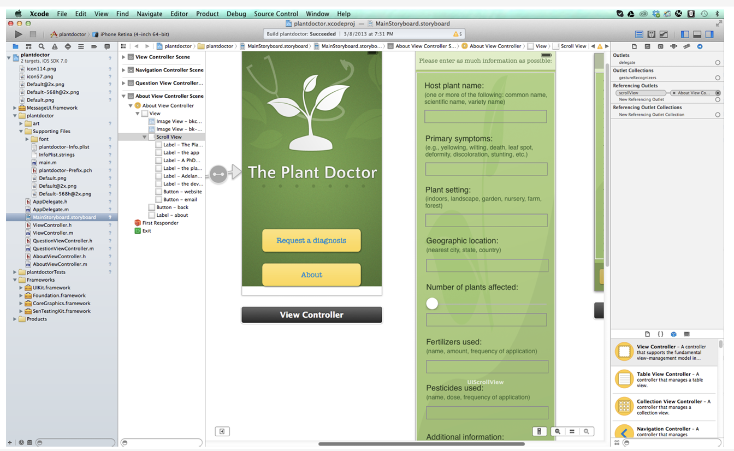

Slide 27
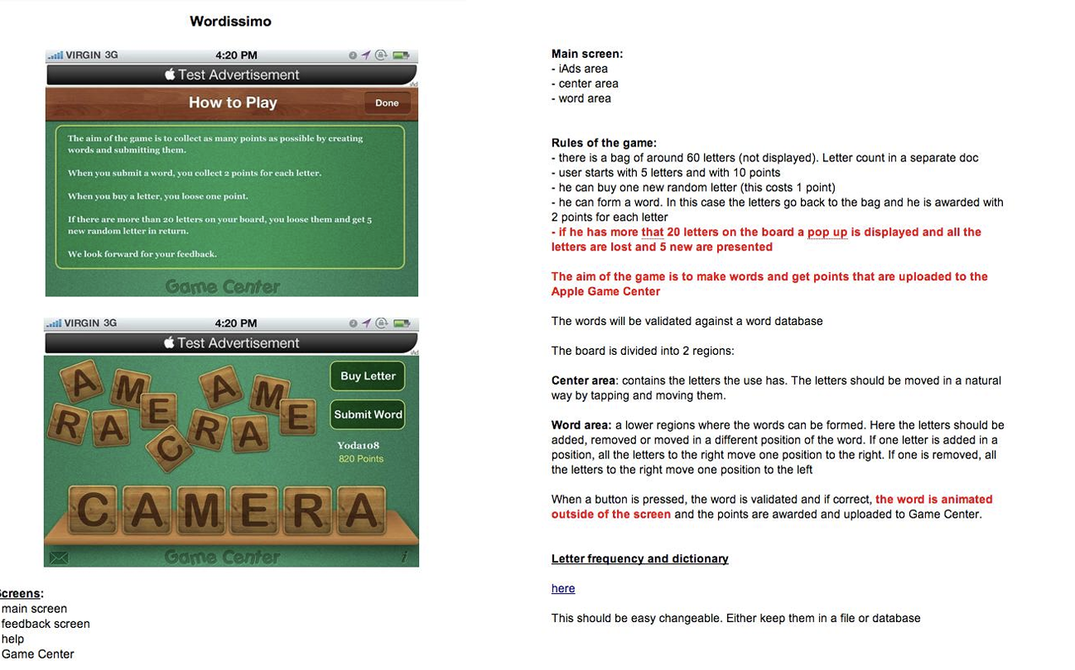
Example: The requirements and the use case documents for the “Wordissimo” app appear on the following screens.

Slide 28
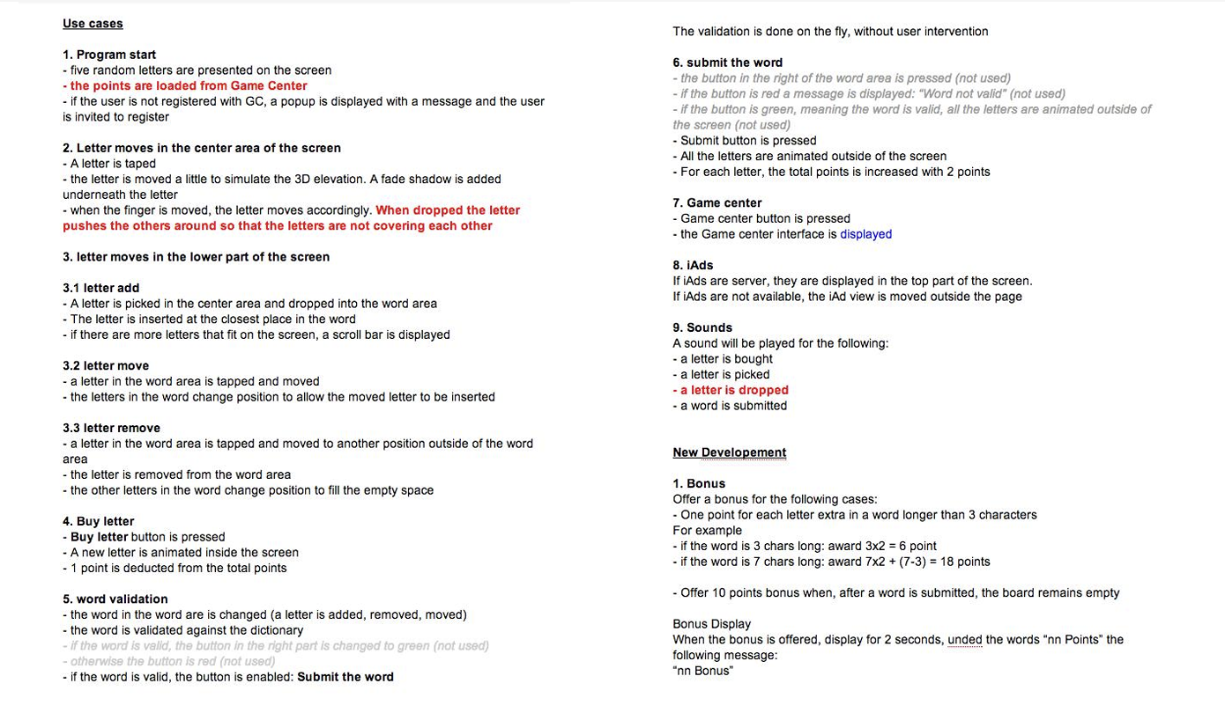

Slide 29
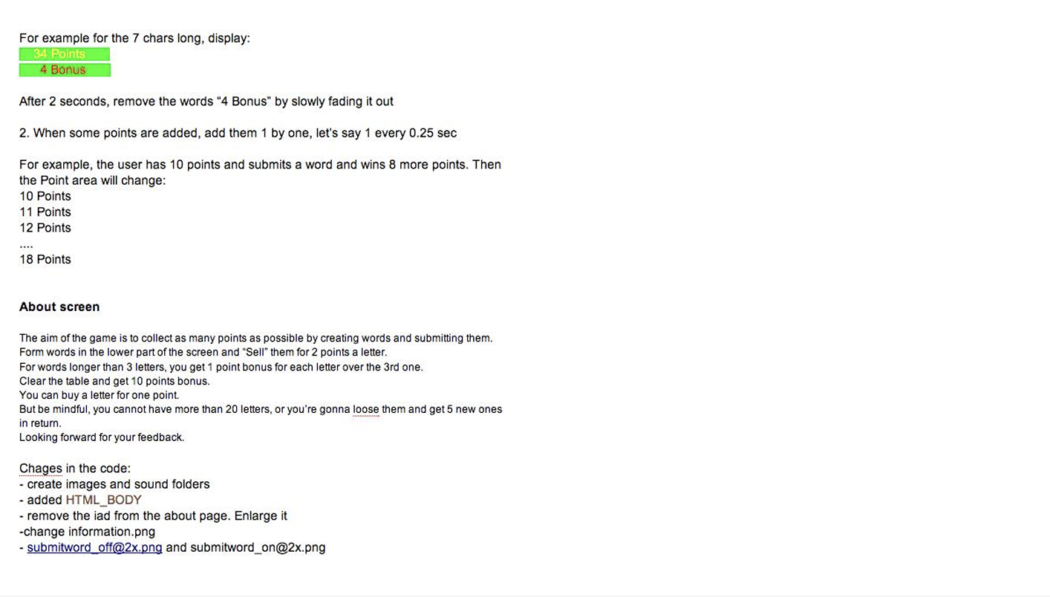

Slide 30
Graphic design
● Appearance of the app is very important and should be a high priority, with sufficient budget provided for graphics. ● Graphic design is best done professionally. Costs : Romania = $200 to $300 per screen USA = $500 per screen One can expect much higher costs for the unique design of multiple screens. The cost for “The Plant Doctor” graphics design was $300.

Slide 31
Considerations in graphics design:
● Colors and color theme (background, buttons) ● Art ● Text (size, color, font) ● Layout ● Balance ● Layering

Slide 32
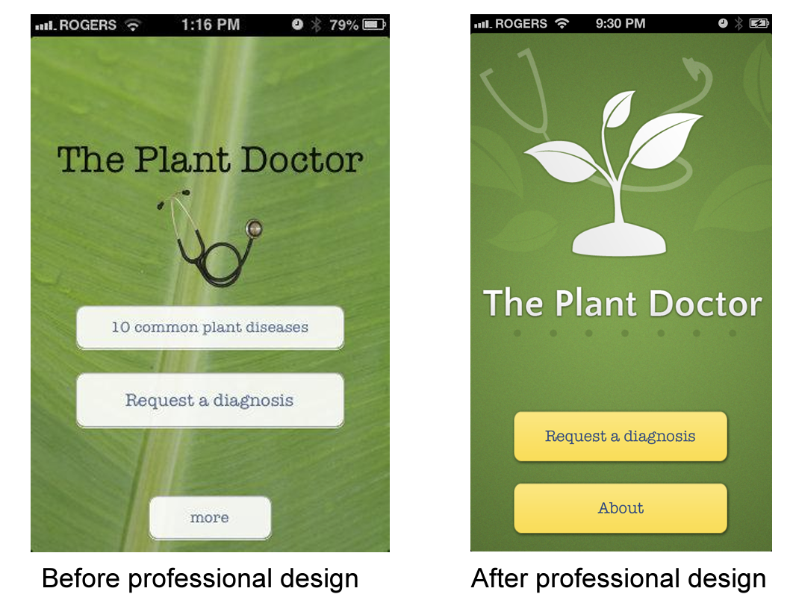
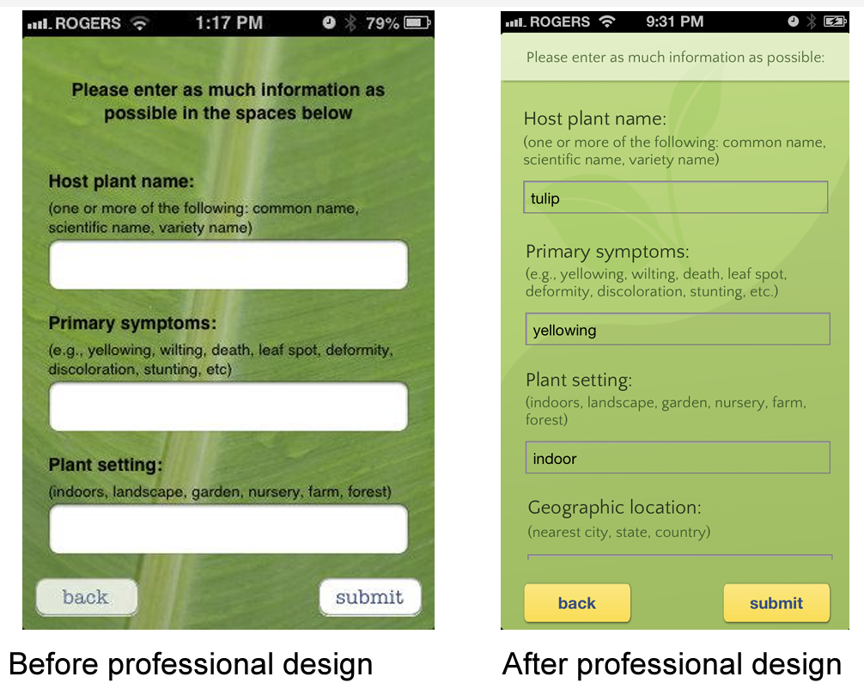
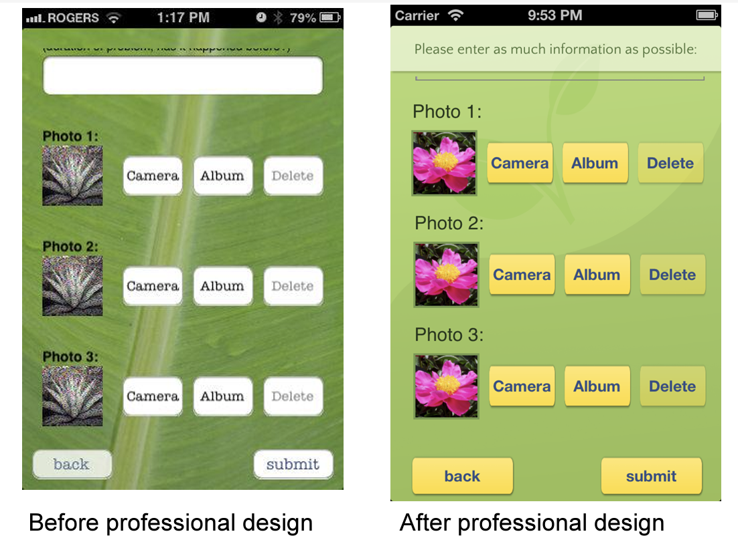

Slide 33
Submission and approval
Apple: checks for no crashes; the app does what is says it will do; and minimum information content may be needed Developer accounts: Apple: Developer’s license = $100/year Google: Developer’s license = $20/year Note : For the for-sale apps, payment to Apple or Google is 30% of your profit. Free apps do not incur this charge.

Slide 34
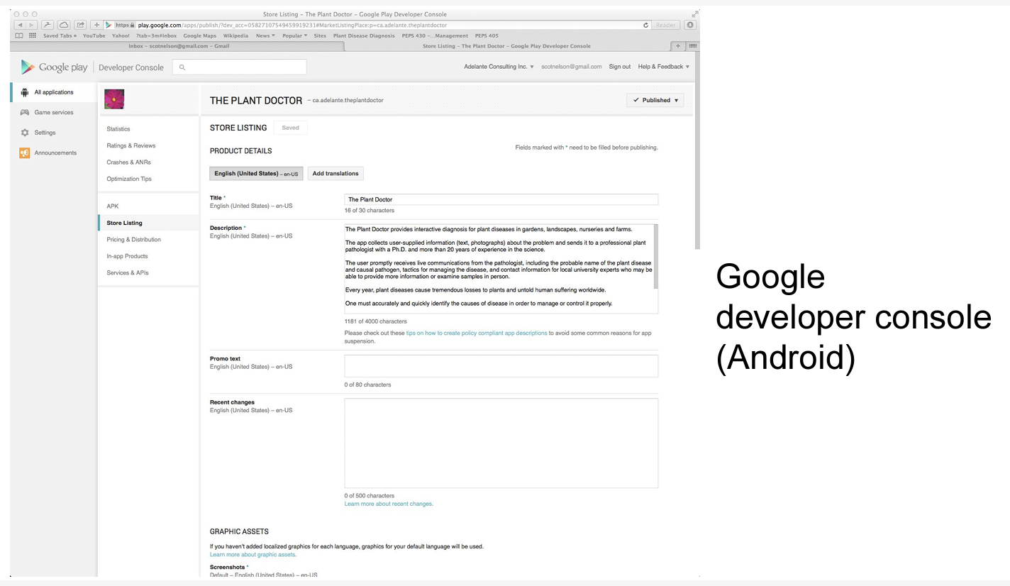

Slide 35
Updates for apps may be required as new versions of phones emerge onto the market. The new phones may have updated or newer versions of software which require app updates. App developers should prepare for this eventuality. Example: “The Plant Doctor” had to be updated for use on iPhone 5.

Slide 36
Common pitfalls
1. Do not build an app without having the intended device nor without having experience using the device (the environments, menus and appearance differ among devices) 2. Have a very clear idea of what the app will do 3. Develop the flow of processes clearly and precisely 4. Ensure that your budget is sufficient to completely fund the development of the app

Slide 37
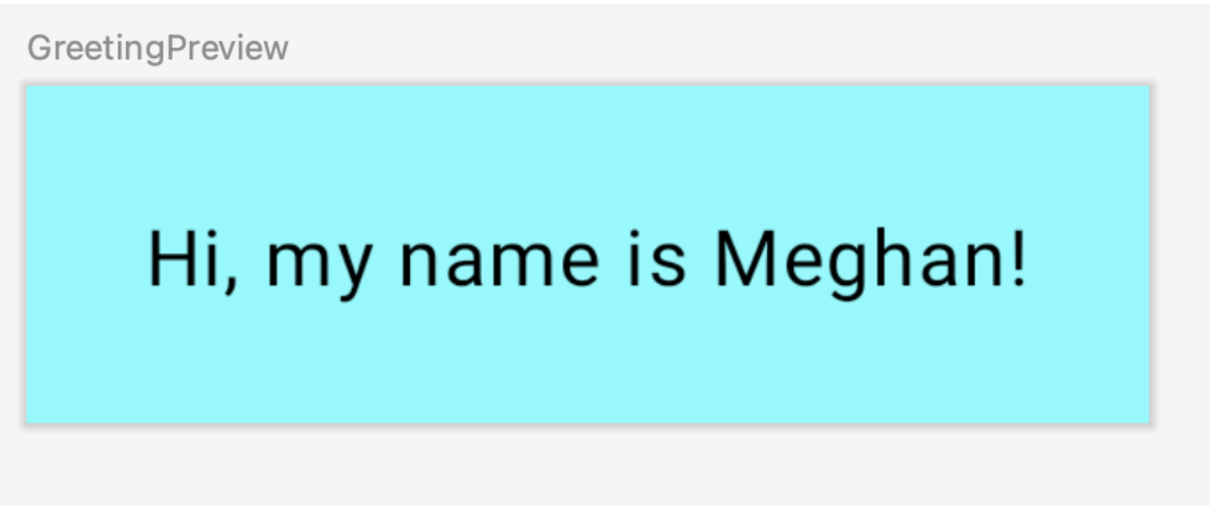
Create your first Android app
https://developer.android.com/codelabs/basic-android-kotlin-compose-first-app#0

Slide 38
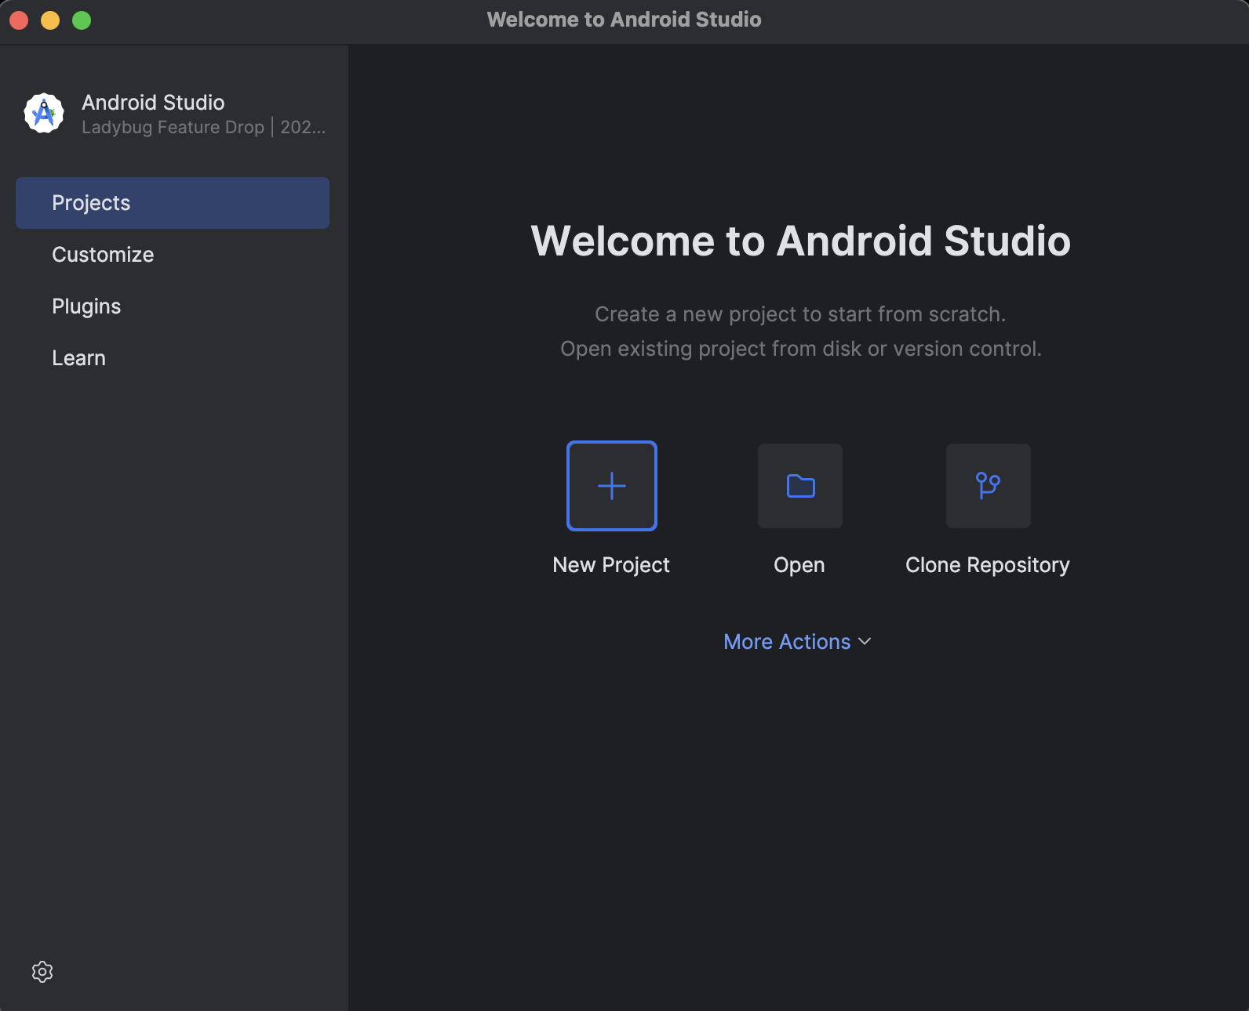
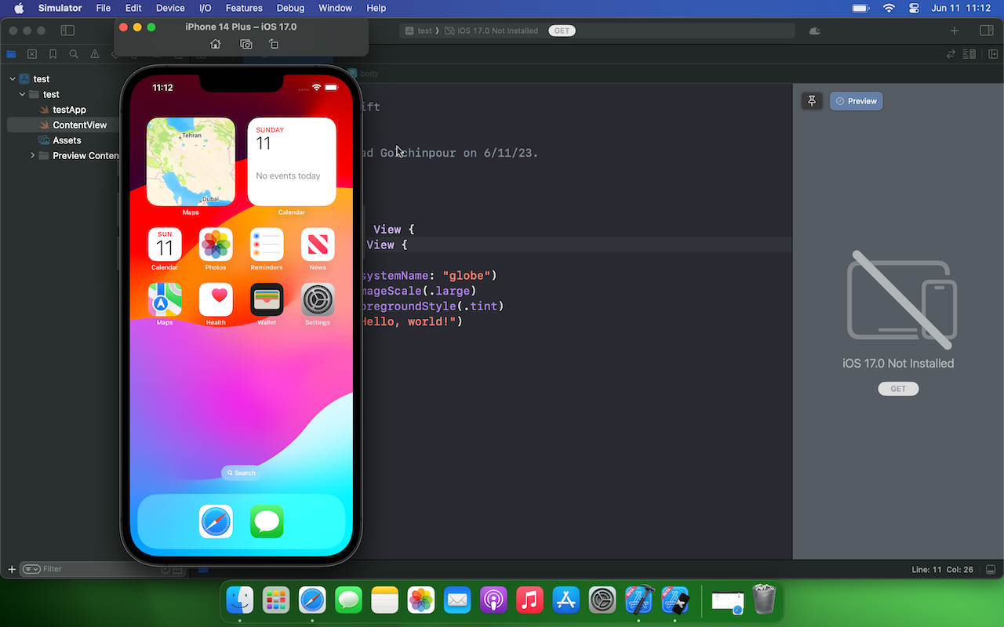
Android studio vs Xcode

